Slide 1

Department of Computer Science &Engineering Artificial Intelligence & Machine Learning
A.P. Shah Institute of Technology G.B.Road,Kasarvadavli, Thane(W), Mumbai-400615
UNIVERSITY OF MUMBAI
Academic Year 2023-2024

Slide 2
E-Authentication
Computer Science & Engineering Artificial Intelligence and Machine Learning
By
Bhushan Kokate (22106070)
Durvesh Kanade (22106013)
Eshwari Parab (22106066)
Vaishnavi Dumbre (22106115)
Under the Guidance of
Prof. Viki Patil

Slide 3
Index
Introduction
Objectives
Features
Literature survey
Block Diagram
Tools/Softwares, Languages used
Implementation
Conclusion
References

Slide 4
Introduction
The process of electronic verification of the identity of a user.
Includes multi-factor authentication for added protection.
Plays a critical role in the modern digital landscape.
Important aspect for cyber security.

Slide 5
Objective
The primary objective of e-authentication is to confirm the identity of individuals or entities seeking access to digital systems, services, or data.
E-authentication is crucial for protecting sensitive data during online transactions, communication, and access to digital resources.
E-authentication builds user trust in online services and platforms.
E-authentication helps prevent unauthorized individuals or systems from gaining access to sensitive information or services.
E-authentication is designed to protect users' personal information and privacy.

Slide 6
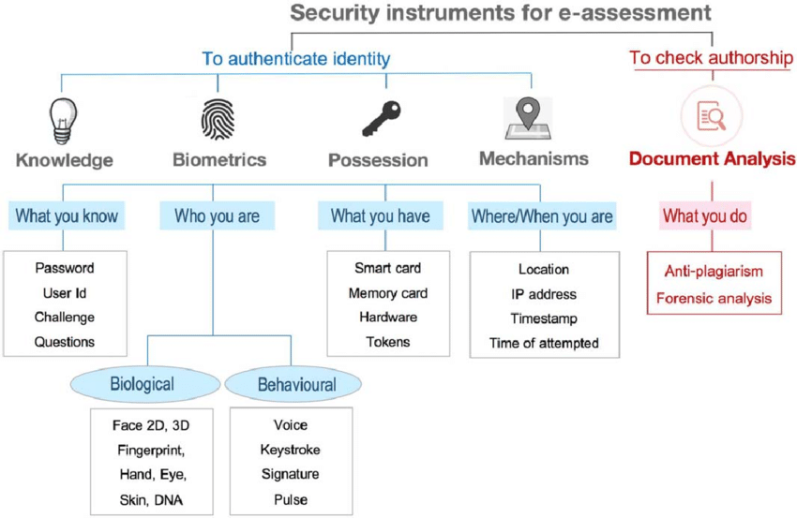
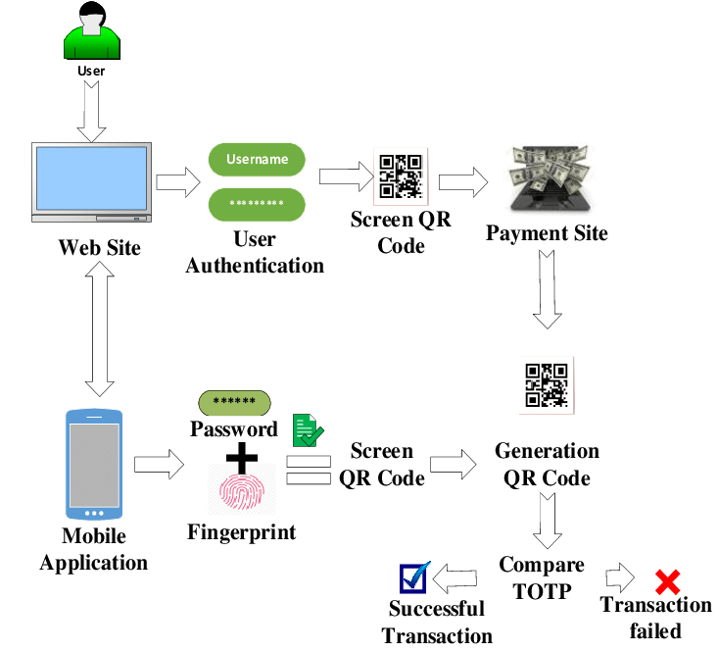
BLOCK DIAGRAM
Figure 1: E-Authentication using multiple phases.
Figure 2: Example of E-Authentication Architecture.

Slide 7





Tools/softwares, Languages used
HTML.
JAVASCRIPT.
Python.
Visual Studio Code
CSS

Slide 8
PROJECT WORK

Slide 9
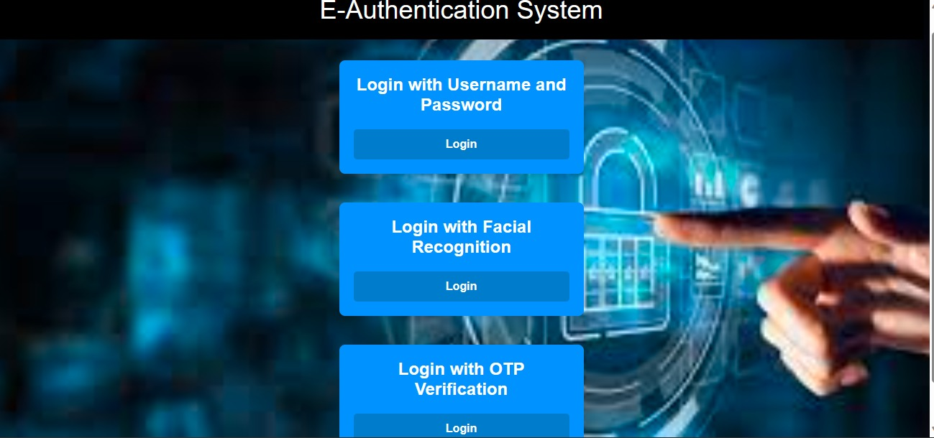
SIGN-UP / LOGIN PAGE

Slide 10

USING USERNAME AND PASSWORD

Slide 11
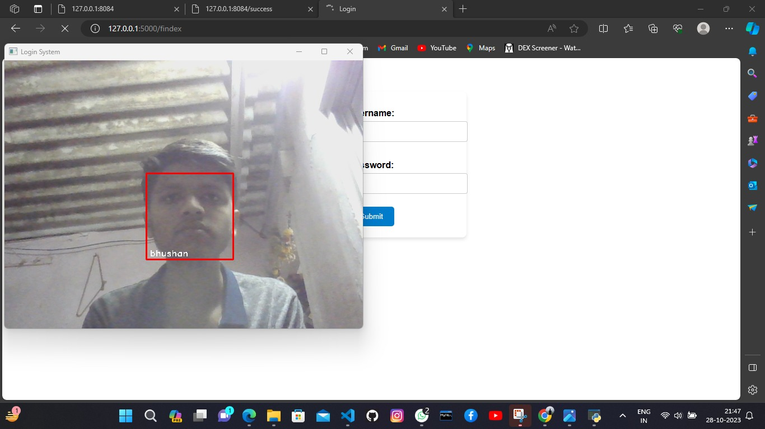
USING FACE RECOGNIITION

Slide 12
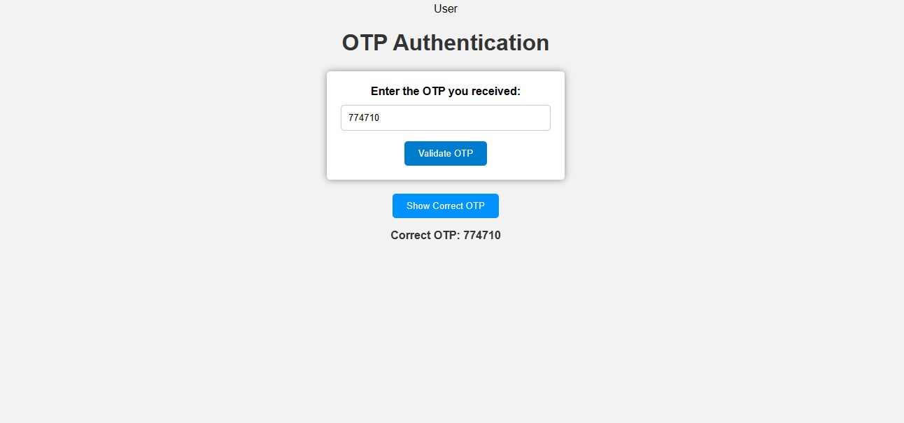
USING OTP VERIFICATION

Slide 13

SUCCESSFUL LOGIN

Slide 14
FUTURE SCOPE
Biometric Authentication: Biometrics, such as facial recognition, fingerprint scanning, and iris scanning, are becoming increasingly popular for e-authentication. This trend is likely to continue as biometric technology improves and becomes more accessible.
Multi-Factor Authentication (MFA): MFA, which combines two or more authentication factors like something you know (password), something you have (smartphone), and something you are (biometrics), is gaining traction. In the future, we can expect more advanced and user-friendly MFA methods.
Artificial Intelligence and Machine Learning: AI and ML can be used to analyze user behavior, detect anomalies, and adapt authentication methods in real-time. This can enhance security while providing a smoother user experience.

Slide 15
Conclusion
E-authentication is a critical component of our increasingly digital and interconnected world. The future of e-authentication holds great promise, with a focus on innovation, user-centric approaches, and enhanced security measures..
User convenience and privacy will be paramount, as individuals seek seamless yet secure ways to access digital services and protect their online Identities.
In a world where cyber threats are ever-present, e-authentication is not just a necessity but a driving force behind the safe and efficient functioning of our digital society.
The integration of artificial intelligence, machine learning, and risk-based approaches will help adapt authentication methods to evolving threats and user behaviors.

Slide 16
References
1. MDN : MDN Web Docs (mozilla.org)
2. Web3School : JavaScript Tutorial (w3schools.com)
3.CodeHelp : (4) Complete Web Dev using MERN stack || Love Babbar - YouTube
4.GeeksForGeeks : Web Development - GeeksforGeeks
5.ChatGpt : ChatGPT (openai.com)

Slide 17



